Slide 1
Ethics in the World of Social Media Communications
Sonya Sanchez, Moderator, Senior Counsel, University of California
Alexander (Sandy) Bilus, Partner, Saul Ewing Arnstein & Lehr LLP
Charles Harris, Partner, Mayer Brown LLP

Slide 2
Outline
Confidentiality in Social Media
Marketing Pitfalls
To Friend or Not To Friend
Avoid Using Fake Profiles
Fake News: Think Before You Share
Pitfalls with “Cleaning” Clients’ Profiles
Beyond Ethical Violations: Reputational Risk
Emojis, Emoticons, and Hashtags
The Twitter Ratio
Even Perceived Benefits of Social Media Not Without Risk

Slide 3
Introduction
Ubiquity of Social Media
  2018 PEW survey: 79% Americans use social media regularly; 85% attorneys use social media for advertising
  TX Lawyers Facebook Group is largest voluntary bar association in TX
Social Media and the 24/7 News Cycle
  Encourages people to react to news cycle and generates viral stories that drive news cycle
  Ill-advised tweets and videos / photos of attorneys behaving badly draw news coverage
Informality of Social Media and Rapidity of News Cycle creates pitfalls for lawyers

Slide 4
Confidentiality in Social Media

Slide 5
Confidentiality in Social Media
ABA Model Rule 1.6(a)
  Generally prohibits lawyers from revealing any information relating to an ongoing representation without client’s informed consent
  Even identity of clients is off limits
ABA Formal Opinion 480
  The norm of attorney-client confidentiality “is essential to the attorney-client relationship”

Slide 6
Confidentiality (cont.)
Impulsive and Thoughtless conduct
  Social media plays into human tendency to show off to attract attention
  AUSA disbarred for pseudonymously posting hundreds of comments about ongoing cases on website of newspaper
  Assistant public defender suspended for blogging about the clients she was defending

Slide 7
Confidentiality (cont.)
Public Availability Not an Excuse
  Rule 1.6(a): Ongoing Representations
    Disclosure of any info relating to client rep. regardless of public availability (even identity of client!) requires informed consent
  Rule 1.9(c): Past Representations
    Use of information allowed even if use disadvantages former client. BUT
    Revelation of information relating to past representations is subject to same restrictions as Rule 1.6. I.e., Informed Consent required.

Slide 8
Marketing Pitfalls

Slide 9
Marketing Pitfalls
False Statements of Law or Fact
  Rule 4.1(a) prohibits “mak[ing] a false statement of material fact or law to a third person”
    Keep website and blog posts up to date; remove if no longer accurate / not good law
  Rule 7.1 prohibits misleading communications about specialization or that creates unjustified expectations
    Advertisements should contain appropriate disclaimers or qualifying statements
    Be wary of identifying or allowing others to identify “skills” or “specialties” on LinkedIn

Slide 10
Marketing Pitfalls (cont.)
Avoid inadvertently creating attorney-client relationships
  Model 1.18 covers confidentiality of prospective clients
  Relationship typically triggered if two-way conversation or if lawyer elicits information
    E.g., website invites people to email questions
  Generally does not cover information that is unilaterally given to a lawyer

Slide 11
To Friend or Not to Friend

Slide 12
Friending a Judge an #EthicsFail?
Some states adopt a bright-line rule that judges may not have any social media contact with lawyers that appear before them.
Others recognize that “friending” is permitted.

Slide 13
Friend Requests and Attorney Ethics
States are generally consistent in finding that attorneys (and their agents) cannot communicate with represented parties via a friend request.
Example of attorney directing paralegal to friend plaintiff in order to obtain information and pictures – held to be a violation of Model Rule 4.2 (communicating with a person represented by counsel), as well as other rules.

Slide 14
Potential Liability for Inappropriate Friending/Communication
Inappropriate friending can result in civil or criminal liability
  Common law torts such as intentional infliction of emotional distress
  Violation of VAWA
  Criminal statutes prohibiting harassment or stalking
Friending may also violate university social media policy, if any (there should be!).

Slide 15
Potential Liability for Inappropriate Friending/Communication
In addition to the “friender” being held liable, a university could potentially be held liable for actions of its faculty or employees under a vicarious liability theory if the faculty member or employee was acting within the scope of his or her employment.

Slide 16
Fake Profiles: Why they are Never a Good Idea

Slide 17
Fake Social Media Profiles
Former district attorney example
  Using a fake profile to “snoop” on suspected bath salt dealers
  Using fake account to become friends with defendants in criminal case and encouraging staff to do the same
Disciplinary Board found that the fake Facebook account constituted “fraudulent and deceptive conduct” in violation of applicable rules on professional ethics.

Slide 18
Fake News: Recognize it and Think Before you Share

Slide 19
Recognizing “Fake News”
False stories are seventy percent more likely to be retweeted on Twitter than true ones.
  EX: A story about a woman’s extreme reaction to winning the lottery, which was fake, was shared almost 1.77 million times on Facebook.
How does this apply to higher education?

Slide 20
Fake News
Fake news is everywhere and is likely being spread on your university or college campus.
To determine hot topics being shared on your campus, review campus publications, Twitter hashtags that are trending, or a simple Google search.
If fake news is spreading, in-house attorneys should collaborate with colleagues in their communication department to decide the best way to respond.

Slide 21
Can/Should Attorneys Recommend Clients “Clean Up”
Social Media Accounts?

Slide 22
“Cleaning Up” Social Media
Generally, an attorney can advise a client to use discretion when posting on social media or advise the client to refrain from posting.
  Some states have found a lawyer’s duty to provide competent and diligent representation requires the attorney to advise the client of legal ramifications of posting and social media comments.

Slide 23
“Cleaning Up” Social Media
While an attorney may advise a client about future postings, an attorney should be cautious about advice regarding existing social media content.
Advising a client to remove social media posts may constitute obstruction of justice or spoliation of evidence.
  Virginia example of attorney who advised client to delete Facebook (after being served discovery requests) and then signed a document request saying that the client did not have a Facebook

Slide 24
What could a social media blunder or outburst mean for an attorney’s reputation?
Thinking beyond ethics violations
  Examples
    Connecticut lawyer posts racist “meme” on Facebook.
    Florida lawyer attacking opposing counsel on social media.
What will your followers, clients, and potential clients think of you based off of your posts?

Slide 25
Maintaining an Upstanding Reputation
Draw a clear line between personal and professional social media accounts
  Be aware that professional contacts may find and read your personal accounts!
Maintain a workplace social media policy
Ensure postings are not construed as legal advice

Slide 26
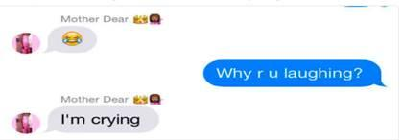
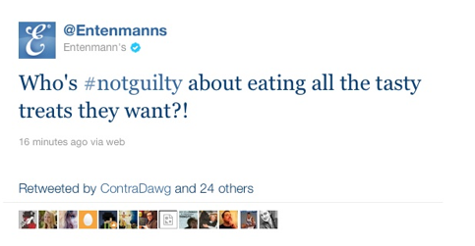
Emojis, Emoitcons, and Hashtags
People might have different interpretations of emojis
Courts may interpret emojis as agreement to a contract or defamatory
Hashtags could be misconstrued and taken out of context
  Entenmanns’ tweet: #notguilty was trending because of the controversial verdict in the Casey Anthony murder trial.

Slide 27
Emojis, Emoitcons, and Hashtags
Attorneys should advise their clients to avoid emoticons and emojis in professional settings, and be wary of using these themselves.
  Emoji-users risk their messages being viewed as unprofessional or even possible sexual harassment
Think before sending: How may this be perceived by the recipient?

Slide 28
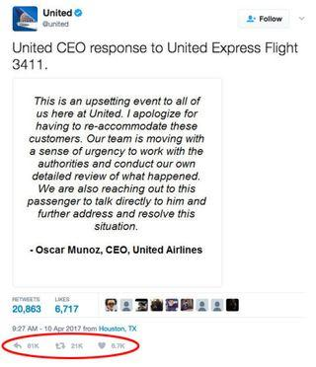
Tweets Gone Bad
If replies to your tweet vastly outpace likes and retweets – something is wrong.
Example: United Airlines tweet had 61,000 replies and only 6,700 likes.

Slide 29
Tweets Gone Bad
Monitor social media accounts for “bad” ratios.
Gauge public opinion and response by tracking and reviewing hashtags pertaining to the University.
If a problem, think strategically how to handle or rectify the situation.
  Utilize PR personnel

Slide 30
Seeking Assistance from Other Attorneys Via Social Media
Social media offers attorneys an opportunity to connect with each other to discuss legal issues, but discussing certain topics could run afoul of the Rules of Professional Conduct.
Example
  Facebook group of Texas attorneys is made up of approximately eleven percent of Texas bar
  The Texas Disciplinary Board found attorneys could use the group for informal lawyer-to-lawyer consultations, but must honor their duty of confidentiality to clients

Slide 31
The Best Laid Plans …
Think before friending students/faculty, especially those who have brought suit against the college or university.
Be prepared to inform faculty about the appropriateness of friending students.
Do not create fake social media profiles (or instruct others to do so)!

Slide 32
The Best Laid Plans
Be vigilant in verifying news that is disseminated and take reasoned approach to combatting fake news.
Consider whether you have a proper procedure in place for implementing a litigation hold, if needed to preserve social media content.

Slide 33
The Best Laid Plans
Utilizing social media to connect with other attorneys to confront a legal issue could greatly benefit a University, but attorneys taking advantage of these platforms should use extreme caution not to breach their duty of confidentiality.
Remain cautious of information or advice received on any online platform, even if it is coming from another attorney.
Do not disclose any information that might identify your client or their legal issues.

