Slide 1
The General Data Protection Regulation is coming
Are you ready?
Charles-Albert Helleputte
Partner
Mayer Brown
+32 2 551 5982
chelleputte@mayerbrown.com

Slide 3
Welcome
You were invited by ECOO to attend today’s event
In order to register to the event, you sent an email to ECOO with your contact details
What should have happened (if anything) between ECOO and Mayer Brown Brown
What happens now?
Notes:
3

Slide 4
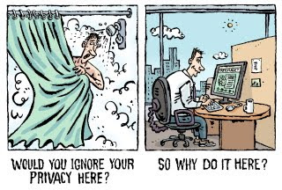
Topics We Will Cover Today
GDPR: Key Changes
Hot GDPR Topics for the Healthcare Industry: Processing Sensitive Personal Data
GDPR Compliance in 8 Steps

Slide 5
The Role of Personal Data in the Optical and Optometric Sector
Optical and optometric businesses routinely gather significant amounts of personal data related to:
Identity: name, address, phone number and email address, etc.
Health status: general health conditions, symptoms, medication, previous optical prescriptions, referrals, etc.
Finances: payment details, etc.

Slide 6
GDPR: The Key Changes
A Regulation, not a Directive: The GDPR will be directly applicable in in all EU Member States
Extra-territorial scope: Non-EU businesses that process personal data in relation to the offer of goods or services to individuals within the EU, or as a result of monitoring individuals within the EU, will now have to comply
Significantly higher fines: The maximum fine will be substantially increased to 4% of a company's worldwide turnover or €20 million per infringement, whichever is higher
New data loss notification obligation: The relevant DPA must be notified without undue delay and where feasible within 72 hours. The individuals affected may also have to be notified

Slide 7
GDPR: The Key Changes
New data privacy governance requirements: A data protection officer may have to be appointed and organisations will be required to map their processing activities and undertake data protection impact assessments for higher risk processing
A requirement to implement “privacy by design”: Businesses must take a proactive approach to ensure that an appropriate standard of data protection is the default position taken
Strengthening of individuals’ rights to personal data: Individuals will have ‘right to be forgotten’, the ‘right to data portability’ and the right not to be subjected to automated data profiling
Obligations on both data controllers and data processors: Service providers will be held accountable for their own level of appropriate security, must document their processing to the same extent under the GDPR and must obtain prior consent to use sub-processors

Slide 8
GDPR Hot Topics: Processing Sensitive Personal Data
8

Slide 9
Processing Sensitive Personal Data
Sensitive personal data are granted a higher level of protection under the GDPR.
Sensitive data = data on racial or ethnic origin, political opinions, religious or philosophical beliefs, sexual life, sexual orientation, trade union membership, genetic data, health data, biometric data
Data concerning health = personal data related to physical or mental health of a natural person, including the provision of health care services, which reveal information about his/her status

Slide 10
Processing of Sensitive Personal Data
Need to rely on one of the legal grounds provided by Article 9 GDPR
The most relevant for optical and optometric businesses are likely to be:
Member States may maintain or introduce further conditions, including limitations
Processing necessary for medical diagnosis, the provision of health care, or pursuant to contract with a health professional (when the professional is subject to professional secrecy obligations)
Data subject’s specific consent

Slide 11
GDPR Compliance in 8 steps

Slide 12
GDPR Compliance in 8 Steps

Slide 13
GDPR Compliance in 8 Steps
1
Inform Your Leadership, Formulate a Plan
2
Map the Personal Data that Your Organisation is Processing
3
Decide Whether a Data Protection Officer Should be Appointed
5
Review the Grounds Under Which Personal Data is Being Processed
6
Draft or Review Information Notices
7
Update Your Data Governance Policies and Procedures
8
Review Your Contracts with Third Parties
4
Address the Risks Identified in Any Data Processing Activities

Slide 14
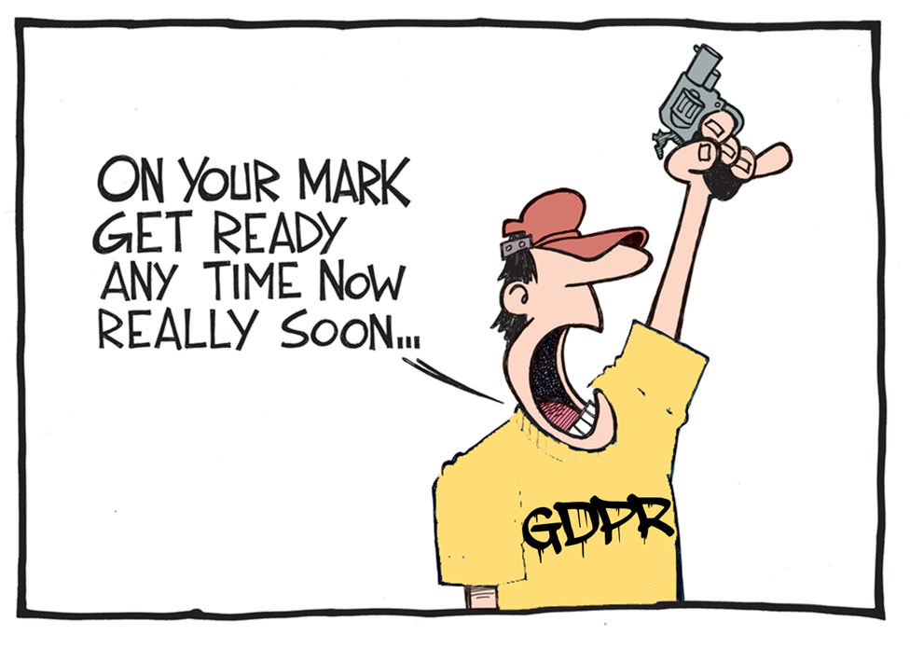
14

Slide 15
Step 1: Inform Your Leadership, Formulate a Plan
Make sure that decision makers and key people in your organisation are aware that the law is changing to the GDPR.
Provide a preliminary assessment of the application of the GDPR to your organisation
Ask external advisors to brief your organisation
Draw up a high-level framework of the GDPR requirements that must be put into operation

Slide 16
Step 2: Map Your Personal Data
What do I need to “map”?
Type of data and any classification
Location of data
Form of collection (or how it is obtained)
Purposes of the collection and processing
Details on storage (including where stored and who manages the system; whether there are back-ups)
Encryption and destruction schedule
Transfers and disclosures between business and third parties
How do I “map” it?
Gather information
Make a plan
Identify and review relevant policies
Involve key actors (HR, Communication, IT, etc.)
Ensure mapping is ongoing
Make it visual (i.e., a map)
Identify any gaps

Slide 17
Optical and Optometric Businesses’ Data Mapping
Data processing activity | Categories of personal data | Data subjects | Data collection method | Data processing purpose | Third Party | Data Transfer | Safeguards
Examination
Customer Relationship
Patients records
Marketing
HR data

Slide 18
Trade Associations’ Data Mapping

Slide 19
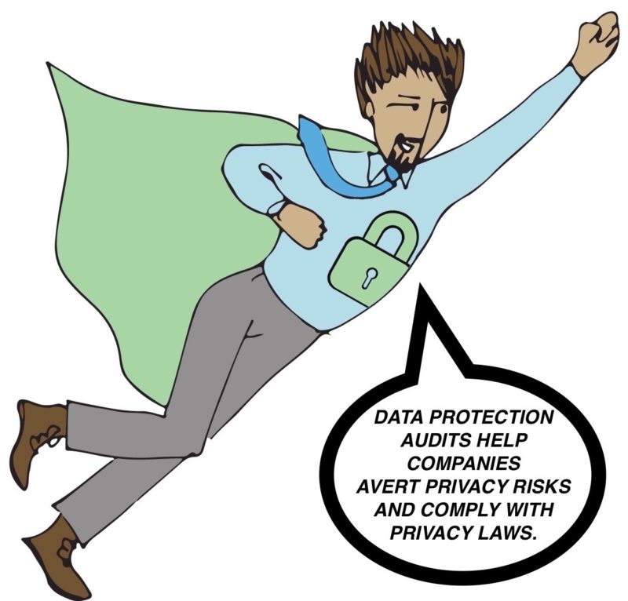
Step 3: Appoint a Data Protection Officer
Optical and optometric businesses may be required to appoint a data protection officer (DPO) who will be responsible for the implementation of the requirements of the GDPR and monitoring compliance with it.
A DPO must be appointed if:
The relevant data processing activity is carried out by a public authority or body
The core activities of the relevant business
involve regular and systematic monitoring of individuals, on a large scale
The core activities of the relevant business involve processing of sensitive personal data, or data relating to criminal convictions and offenses, on a large scale

Slide 20
Step 3: Appoint a Data Protection Officer
Responsibilities of a DPO
Monitor compliance with GDPR
Assist with the production of DPIAs
Pay particular attention to high risk processing
Available for data subject concerns
Cooperate with DPAs
Rights of a DPO
Sufficient funding and access to perform the role
Certain degree of autonomy
Protected under the GDPR from unfair dismissal/termination in some cases
Business must involve the DPO from the outset in all related issues

Slide 21
Step 4: Conduct a Data Protection Impact Assessment
Data protection impact assessments (DPIAs) should be conducted to identify and minimize the risks associated with the processing of personal data
DPIAs required particularly where there are high risks to the rights and freedoms of the individuals concerned by the activities carried out
Systematic, extensive evaluation of personal aspects of persons based on automated processing – i.e., profiling
The processing of a large scale of sensitive personal data, criminal convictions and offenses
Systematic monitoring of publicly accessible areas on a large scale

Slide 22
Step 4: Conduct a Data Protection Impact Assessment
Recital 91 GDPR and WP29 provide guidance on what “processing of sensitive personal data on a large scale” means:
“Processing of sensitive personal data of patients by an individual physician or other healthcare professional does not require a mandatory impact assessment ”
However, DPIA could be carried out on
a voluntary basis

Slide 23
Step 4: Conduct a Data Protection Impact Assessment
No set format for a DPIA, but it must contain:
A systematic description of the envisaged processing operations and the purposes of the processing
An assessment of the necessity and proportionality of the processing operations in relation to the purposes;
An assessment of the risks to the rights and freedoms of data subjects; or
The measures envisaged to address the risks
DPIA exercise is typically conducted in two parts:
A questionnaire for your business representatives to complete
Carrying out the DPIA itself.

Slide 24
Step 4: Conduct a Data Protection Impact Assessment

Slide 25
Step 5: Review the Grounds for Processing
On the basis of the information gathered during the data mapping exercise, review the legal grounds on which you rely on in order to process personal data
Consider:
The purposes of processing (if you collect personal data for one purpose, you cannot use it for another incompatible purpose)
The context in which you collected the personal data – in particular, your relationship with the individuals and what they would reasonably expect
The nature of the personal data
The possible consequences for individuals of the new processing; and
Whether there are appropriate safeguards in place

Slide 26
Legal Grounds: Consent
Threshold for valid consent significantly increased.
Consent must be: freely given, specific, informed and unambiguous
Need for a clear affirmative action
It must be recorded
It must be unbundled (clearly distinguished from other matters)
Must be withdrawn at any time

Slide 27
Legal Grounds: Consent
IN PRACTICE
When relying on consent, you should provide a “tick-the-box” option or specific statement required to demonstrate acceptance of the proposed processing
Example 1: You may need separate consent to contact your clients for different purposes: sending offers/sales promotions emails, invitation to events, etc.
Example 2: If you rely on consent, when requiring individuals attending conferences or events to fill in a form and provide his/her data during the registration, provide a tick-the-box option or specific statement required to demonstrate acceptance of the proposed processing

Slide 28
Legal Grounds: Necessary for the Performance of a Contract
Controller must conduct a necessity test:
Controller cannot process information that is not necessary for the purposes of the contract.
Need for a close and substantial connection between the data processing and the purposes of the contract.
IN PRACTICE
You can rely on this legal ground when you need to process
your employees’bank account information
in order to provide them with the payment of their salary.

Slide 29
Legal Basis for Processing: Legitimate Interest
IN PRACTICE
Personal data may be processed if the controller has a legitimate interest in processing the data AND if the legitimate interest is not overridden by the rights or freedoms of data subjects.
The assessment is carried out on a case-by-case basis.
Legitimate interest could direct marketing activities. However always ask yourself:
What is the purpose of preventing/detecting fraud and why is it important to you?
Is there another way of achieving the identified interest?
What are the rights and expectations of the data subjects?

Slide 30
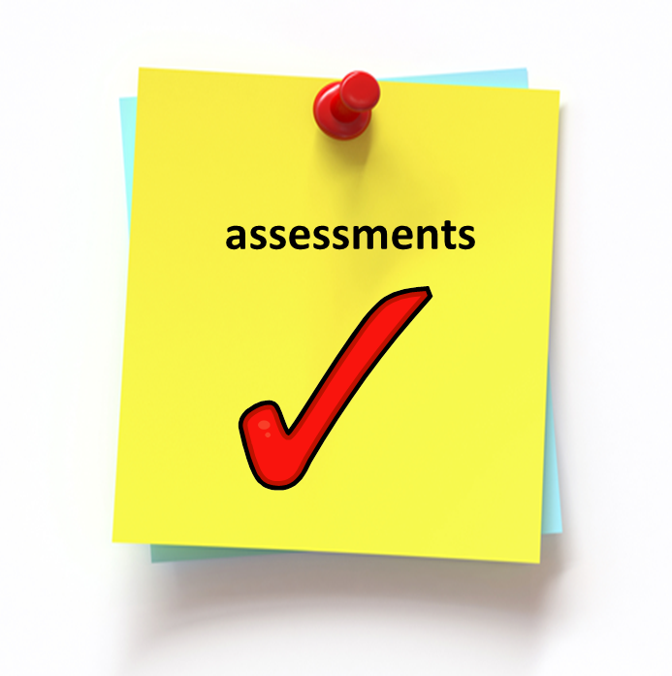
The “Legitimate Interest” Assessment
Determine if the interest is legitimate
Demonstrate compliance to ensure transparency
Establish whether the controller’s interest is overridden by the fundamental rights of the data subject
Establish a balance by taking into account additional safeguards
Determine whether the processing is necessary to achieve the interest pursued

Slide 31
Step 5: Review the Grounds for Processing
What happens to your old database?
You would like to contact all the individuals already included in your database to ask their consent on whether they would like to subscribe to a insurance policy.
Honda Motor Europe fined £13,000
Honda sent an email to 289,790 contacts asking “Would you like to hear from Honda?”
Honda was trying to comply with GDPR: the email was sent in order to clarify how many of the subscribers would like to receive marketing emails going forward.
Key take-away: Even asking for consent is classified as marketing and is in breach of the upcoming GDPR!

Slide 32
Step 6: Review Information Notices
To ensure transparency of processing, controller must provide information notices.
They must be provided at the time data are obtained and must include:
Identity and contact details of the controller
Details of representative and DPO
Purpose and legal basis of processing
Data storage period
Details of data transfers outside EEA and safeguards
Recipients
Use of automated decision making
or profiling
Details of legitimate interests
Rights of access and correction
Right to withdraw consent
Right of complain to DPA
Right of object to data processing
Right of data portability

Slide 33
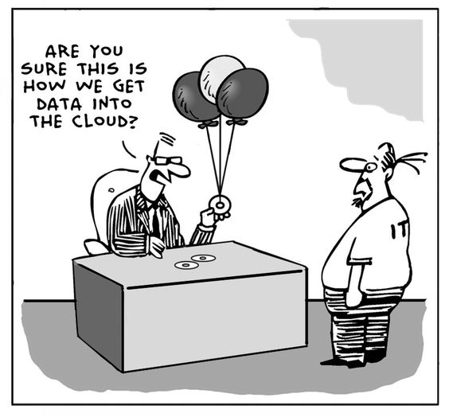
Step 6: Review Information Notices
Given the amount of information, consider drafting layered privacy policy
You should inform individuals:
At the time the information is collected from the relevant individual; or
Where collected from a third party, at the time a communication is made to the data subject, the personal data is disclosed to another third party or within one month of first receiving it at the latest

Slide 34
Step 7: Update Your Data Governance Policies and Procedures
Policies and procedures should be updated to detail how your organisation will practically comply with the new requirements
Data breach notification Policy
Retention and destruction policies
IT security policies
Data processing register
Procedures to respond to data subjects’ requests

Slide 35
Step 7: Focus on Data Breach Notification Obligations
You should update security incident response plan and procedures to detail how your organization would comply with the breach notification requirements under the GDPR and how these would interact with your organization’s existing notification requirements
Data Breach
Risk for data subjects
Within 72 hours unless justified
Notify the DPA
High risk for data subjects
Without undue delay
Notify individuals

Slide 36
Step 7: Focus on Data Breaches incidents – Healthcare Companies
Companies operating in the sector are one of the most vulnerable, due to the amount and type of personal data they collect.
Attacks can result in significant, tangible damages such as fines, legal fees, lawsuits and fraud monitoring costs, as well as a loss of trust.

Slide 37
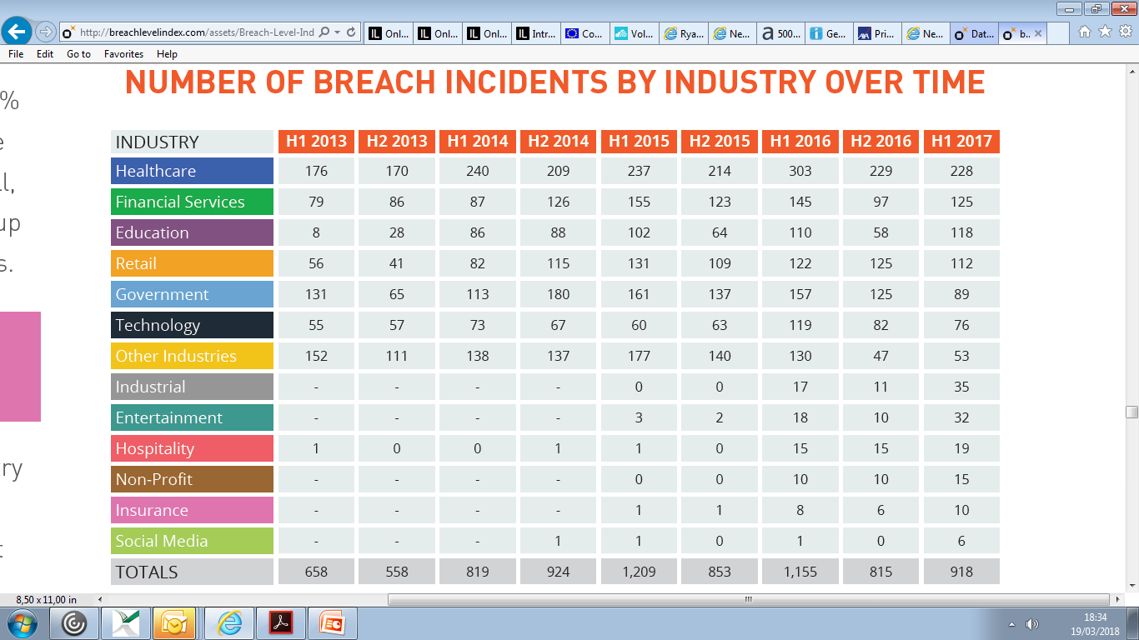
Step 7: Focus on Data Breaches incidents with Healthcare Companies
Source
http://breachlevelindex.com/assets/Breach-Level-Index-Report-H1-2017-Gemalto.pdf

Slide 38
Step 8: Review Your Contract with Third Parties
IN PRACTICE
Controllers must use a high degree of care in selecting processors
Contracts must be implemented that contain a range of information – e.g., data processed and duration, obligations such as data breach reporting, use of technical measures, audit assistance obligations, etc.
Data transfer restrictions apply to controllers and processors. Controllers should review whether any of the third parties they share personal data with is located outside the EEA and ensure they have a legal transfer mechanism in place
When you outsource part of your services to external suppliers (e.g., contact lens suppliers, manufacturers of equipment, marketing companies or external companies that will send newsletters, organise events) you should have data protection agreements in place

Slide 39
You have done all of that by May 25th ? ..... Take some weeks off!

Slide 40
You haven’t?

Slide 41
You don’t need my consent!

Slide 42
Questions? Please contact:
Charles-Albert Helleputte
Partner (Brussels)
T: + 32 (0) 2 551 59 82
E: Chelleputte@mayerbrown.com
Diletta De Cicco
Legal Consultant (Brussels)
T: +32 (0) 2 551 59 74
E:Ddecicco@mayerbrown.com

Slide 43
Thank you for your attention

Slide 44
Notice
The material in this presentation is provided for informational purposes only and does not constitute legal or other professional advice. You should not and may not rely upon any information in this presentation without seeking the advice of a suitably qualified attorney who is familiar with your particular circumstances. Mayer Brown Practices assumes no responsibility for information provided in this presentation or its accuracy or completeness and disclaims all liability in respect of such information.
Mayer Brown Practices is, unless otherwise stated, the owner of copyright of this presentation and its contents. No part of this presentation may be published, distributed, extracted, reutilized or reproduced in any material form (including photocopying or storing it in any medium by electronic means and whether or not transiently or incidentally to some other use of this publication) except if previously authorized in writing.
Mayer Brown is a global legal services organization comprising legal practices that are separate entities (the “Mayer Brown Practices”). The Mayer Brown Practices are: Mayer Brown LLP and Mayer Brown Europe – Brussels LLP; two limited liability partnerships established in the United States, Mayer Brown International LLP, a limited liability partnership incorporated in England and Wales; JSM, a Hong Kong partnership, and its associated entities in Asia; and Tauil & Chequer Advogados, a Brazilian law partnership. The Mayer Brown Practices is known as Mayer Brown JSM in Asia.

