Slide 1
The General Data Protection Regulation – challenges for the hospitality sector
8 November 2017
Charles-Albert Helleputte
Partner, Brussels
+32 2 551 5982
chelleputte@mayerbrown.com

Slide 2
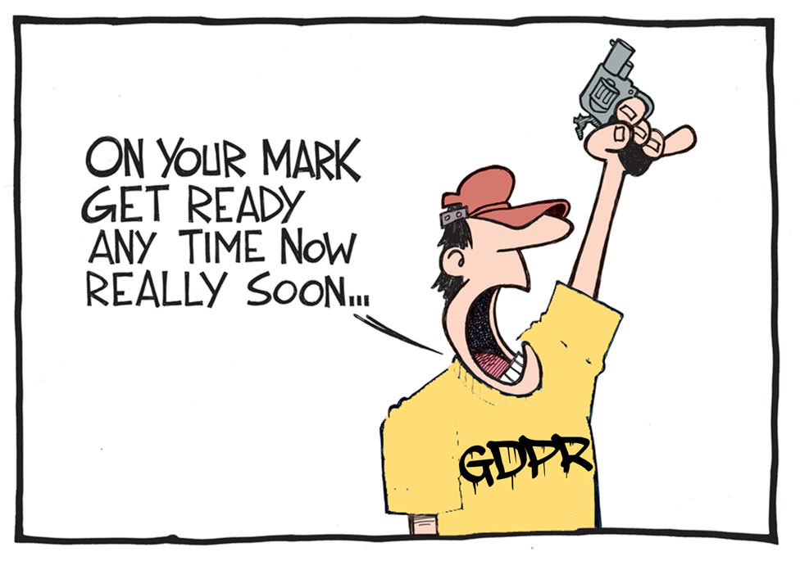

Slide 3
Introduction: personal data in the digital age
Personal data are an essential resource for economic growth, across all sectors
If favorable policy and legislative conditions are put in place, the value of the European data economy may increase to €739 billion by 2020 (4% of the overall EU GDP)

Slide 4
Introduction: personal data in the digital age

Slide 5
The role of personal data in the hospitality sector
Personal data are important in the hospitality sector
Hotels routinely gather significant amounts of their guests personal data at several stages of the guest’s stay:
At Reservation Time : name, address, phone number and email address, etc.
During Check-In: passport number, credit card details, etc.
During the stay : personal characteristics, including sex, age, disability, etc.

Slide 6
The new EU privacy framework
From Directive 95/46 to the GDPR - need to reform EU data protection law:
Directive vs Regulation - Introduction of a single set of rules applying to all Member States
Updating EU privacy law in accordance with new technologies
Facilitating rules for companies
Avoiding costly administrative burdens
Strengthening citizens' fundamental rights

Slide 7
The GDPR reform timeline
January 2012
Reform announced. First draft of GDPR released by European Commission
March 2014
Amended, tougher draft of GDPR adopted by European Parliament
June 2015
European Commission, Parliament and Council start final negotiations on GDPR
December 2015
GDPR final draft agreed by the European Union. Adopted in April 2016
May 25, 2018
The GDPR becomes “law” within the European Union. All organizations must comply by this date

Slide 9
EU privacy law : key concepts
Personal data = any information relating to an identified or identifiable natural person (e.g., name, identification number, location data, an online identifier and data related to physical, physiological, genetic, mental, economic, cultural or social identity)
Processing = any operation or set of operations performed on personal data or on sets of personal data
Data controller = natural or legal person, public authority, agency or other body which determines the purposes and means of the processing of personal data
Data processor = natural or legal person, public authority, agency or other body which processes personal data on behalf of the controller

Slide 10
The GDPR: extraterritorial scope
European Data Protection Directive 95/46 applies to: | General Data Protection Regulation 2016/679 applies to:
A data controller where it is established in an EU Member State and the data is processed in the context of that establishment | The processing of personal data in the context of the activities of a data controller or data processor established in the EU, irrespective of where the processing takes place
A data controller where it is not established in an EU Member State but is using equipment in an EU Member State for processing data otherwise than for the purposes of transit through that Member State | The processing of personal data of data subjects who are in the EU by a data controller or data processor not established in the EU, where the processing activities are related to: The offering of goods or services to those data subjects; or The monitoring of their behaviour in the EU

Slide 11
Assessing whether the GDPR applies to your organization
Offering goods or service to EU individuals | Monitoring individuals
Factors to be considered include: Use of an EU language Use of EU currency References to EU users and customers The international nature of the relevant activity | E.g., tracking of individuals online to create profiles (used to take decisions to analyze/predict personal preferences, behaviors and attitudes).
Example: US based hotel providing EU prices on its website, or providing description of itineraries from EU MS, or telephone numbers with an international code. | Example: International chain using cookies to track individuals worldwide.

Slide 12
Data Protection Principles
8 core Data Protection principles
Transparency
Lawfulness
Security
Quality
Limited purposes
Data minimisation
Integrity
Fairness

Slide 13
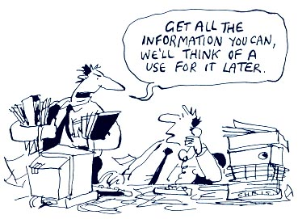
Legal basis for processing
Need to rely on specific legal grounds to process personal data:
Consent
Contractual necessity
Legitimate interest
Vital interest
Public interest
Compliance with legal obligations

Slide 14
Legal grounds: Consent
Threshold for valid consent significantly increased
Consent must be: freely given, specific, informed and unambiguous
Need for a clear affirmative action
It must be recorded
It must be unbundled (clearly distinguished from other matters)
Could be withdrawn “at any time”

Slide 15
Legal grounds: Consent
IN PRACTICE
If you rely on consent, when requiring guests to fill in a form and provide his/her data during the reservation, tick-the-box option, or specific statement required to demonstrate acceptance of the proposed processing

Slide 16
Legal grounds: necessary for the performance of a contract
Controller must conduct a necessity test:
Controller cannot process information which are not necessary for the purposes of the contract
Need for a close and substantial connection between the data subject and the purposes of the contract

Slide 17
Legal grounds: necessary for the performance of a contract
IN PRACTICE
Relevant if you need to process your employee’s personal data to provide the payment of their salary
If the processing is necessary to access your services, you should rely on “necessity for the performance of a contract” rather then consent

Slide 18
Legal grounds: legitimate interest
Personal data may be processed if the controller has a legitimate interest in processing the data AND if the legitimate interest is not overridden by the rights or freedoms of data subjects
The assessment is carried out on a case-by-case basis

Slide 19
Legal grounds: legitimate interest
IN PRACTICE
Legitimate interests include:
Processing for direct marketing purposes or preventing fraud
Transmission of personal data within a group of undertakings for internal administrative purposes (e.g., processing employees’ data)
Processing for the purposes of ensuring network and information security

Slide 20
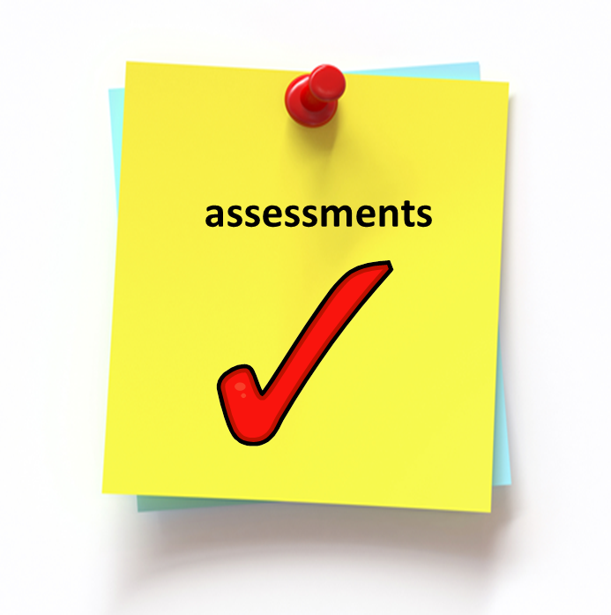
The “legitimate interest” assessment
Determine if the interest is legitimate
Demonstrate compliance to ensure transparency
Establish whether the controller’s interest is overridden by the fundamental rights of the data subject
Establish a balance by taking into account additional safeguards
Determine whether the processing is necessary to achieve the interest pursued

Slide 21
Processing of special categories of data
Sensitive data = data on racial or ethnic origin, political opinions, religious or philosophical beliefs, sex life, sexual orientation, trade union membership, genetic data, health data, biometric data
They are granted a higher level of protection: need to rely on a specific legal ground (e.g., explicit consent of the data subject)

Slide 22
Processing of special categories of data
IN PRACTICE
You are processing sensitive data when:
Example 1. information given for the purpose of choosing the appropriate treatment in a hotel spa
Example 2. information on allergies when booking a table at the hotel’s restaurant

Slide 23
Information notices
Transparency of processing requires controller to provide information notices.
They must be provided at the time data are obtained (POC) and must include:
Identity and contact details of the controller
Details of representative and DPO
Purpose and legal basis of processing
Data storage period
Details of data transfers outside EEA and safeguards
Recipients
Use of automated decision making
or profiling
Details of legitimate interests
Rights of access and correction
Right to withdraw consent
Right of complain to DPA
Right of object to data processing
Right of data portability

Slide 24
Data subject’s rights
Right to rectify: data subject have the right to ask for correction when data are inaccurate or incomplete
Right to object : individuals have the right to object to the processing, for examples if based on legitimate interest
Right to restrict the processing: data subjects have the right to restrict the processing of their personal data in some specific circumstances

Slide 25
Data subject’s rights
Right of access : data subjects can ask for confirmation that their data is being processed and to access the data
Right to be forgotten: the data subject has the power to ask the erasure of his personal data by the data systems (in specific circumstances)
Right to data portability: the data subjects may ask for personal data to be transferred directly from one controller/processor to another

Slide 26
New data governance obligations
Privacy Impact Assessment: Organizations are required to map their processing activities and undertake data protection impact assessments for higher risk processing (examples of high risks for individuals, e.g., processing credit card details during a reservation, processing health data in a spa, etc.)
A requirement to implement ‘privacy by design’: Businesses must now take a proactive approach to ensure that an appropriate standard of data protection is the default position taken

Slide 27
New data governance obligations
DPO: Under the GDPR, public authorities and organizations which carry out intrusive processing will have to formally appoint a Data Protection Officer (“DPO”)
Record of processing activities: organizations have to demonstrate that their processing activities comply with EU data protection rules, meaning that controllers will need to keep detailed records of the processing activities they carry out
Direct compliance obligations for processors = under the Directive processors had only contractual obligations. Under the GDPR, processors have direct legal compliance obligations, and DPAs have the power to take enforcement actions against them

Slide 28
Appointing a DPO
A DPO must be appointed if:
The relevant data processing activity is carried out by a public authority or body
The core activities of the relevant business involve regular and systematic monitoring of individuals, on a large scale
The core activities of the relevant business involve processing of sensitive personal data, or data relating to criminal convictions and offenses, on a large scale

Slide 29
The role of the DPO
Responsibilities of a DPO
Monitor compliance with GDPR
Rights of a DPO
Assist with the production of DPIAs
Attention to high risk processing
Available for data subject concerns
Cooperate with DPAs
Sufficient funding and access
Certain degree of autonomy
Protected from unfair dismissal/termination
Business must involve the DPO from the outset in all related issues

Slide 30
Data Protection impact assessment (DPIA)
A DPIA must be conducted with respect to activities that are likely to result in a high risk to the rights and freedoms of the individuals concerned, particularly when using new technologies
These include activities that involve:
Systematic, extensive evaluation of personal aspects of persons based on automated processing – i.e., profiling
The processing of sensitive personal data, criminal convictions and offenses
Systematic monitoring of publicly accessible areas on a large scale
Data transfers outside the EU

Slide 31
Data Protection impact assessment

Slide 32
Data Breaches notification obligations
Data breaches = breach of security leading to the accidental or unlawful destruction, loss, alteration, unauthorized disclosure of, or access to, personal data transmitted, stored or otherwise processed
Data processors must report personal data breaches to data controller
Data controller must maintain an internal breach register
Data Breach
Risk for data subjects
Within 72 hours unless justified
Notify the DPA
High risk for data subjects
Without undue delay
Notify individuals

Slide 33
High Profile Hotels’ Breaches
Companies operating in the hospitality business are vulnerable to breaches due to the amount and type of personal data they collect
Data breaches in the hospitality sector include:
InterContinental Hotels Group – 2017
Hutton Hotel – 2016
Noble House Hotels and Resorts – 2016
Hyatt – 2015
Trump Hotels – 2014
Hilton – 2014

Slide 34
High Profile Hotels’ Breaches
Data breaches may happen through third parties:
Sabre Hospitality Solutions - 2017 - Multiple hotel companies, including Hard Rock Hotels & Casinos, Four Seasons Hotels and Resorts, Trump Hotels and Loews Hotels, reported a data breach via a third-party reservations system provided by Sabre Hospitality Solutions

Slide 35
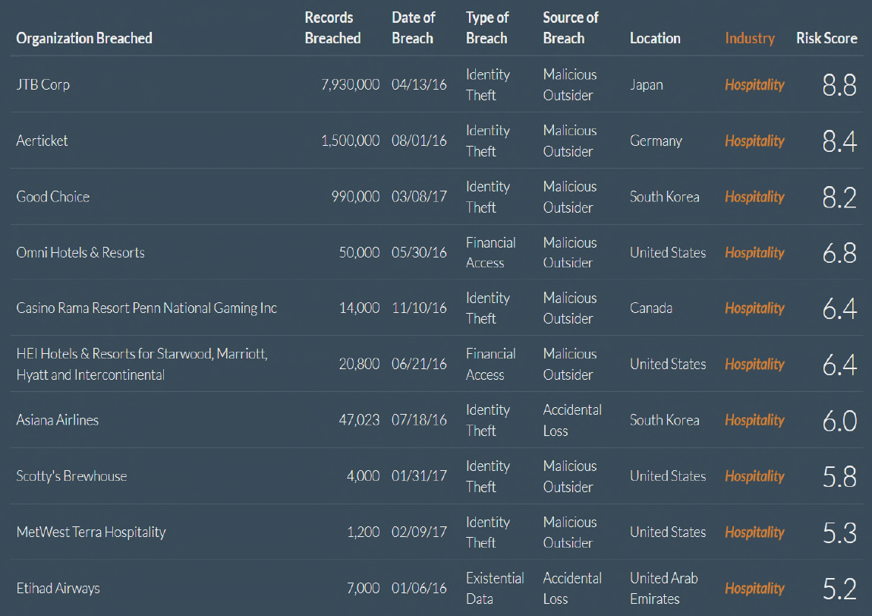
Data breaches in the hospitality sector
http://breachlevelindex.com
/

Slide 36
Transfer of personal data outside the EEA
Transfers of personal data outside the EEA are in principle excluded
Transfers must be based on a legal transfer mechanism:
Adequacy decisions = decisions granted by the EU Commission to third country or international organizations ( i.e., Privacy Shield)
Appropriate safeguards, including :
Standard contractual Clauses (“SCCs”)
Binding Corporate Rules (“BCRs”)
Approved code of conduct
Approved certification mechanism

Slide 37
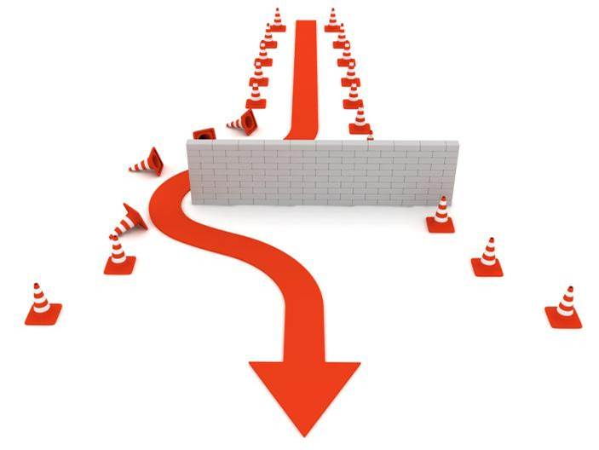
Transfer of personal data outside the EEA - derogations
If (1) and (2) are not available, transfers can be based on derogations:
Explicit consent
Contractual necessity
Important public interest reasons
Litigation necessity
Vital interests
Public register data
Legitimate interest of the controller.

Slide 38
Transfer of personal data outside the EEA - derogations
IN PRACTICE
Example 1. Hotel based in the EU uses a service provider to deal with reservations. If the service provider is based outside the EU, and guest’s personal data are transferred out of the EEA, the company must rely on a specific legal transfer mechanism
Example 2. If guests’ personal data are transferred between different locations of an international chain (inside and outside the EEA), the company could opt for BCRs

Slide 39
GDPR Enforceability
Sanctions
DPAs can:
Issue warnings and reprimands
Order to comply with data subjects’ request
Order to bring processing into compliance
Issue temporary or permanent ban
Fines up to the greater of:
4% annual worldwide turnover
20 million or
DPAs’ powers
…. with a number of variations depending on the nature of the infraction

Slide 40
Get ready to comply with the GDPR
NOVEMBER 2017 (it is not too late, but it is time to act)
MAY 2018
1. INFORM
2. DECIDE
3. MAP
4. EXAMINE
5. ADDRESS
6. EVALUATE
7. UPDATE
8. DESIGN AND IMPLEMENT
9. REVIEW
10. ASSESS

Slide 41
Get ready to comply with the GDPR
Inform your leadership; formulate a plan
Decide whether a data protection office should be appointed and a data protection framework created
Map personal data that your organization is processing
Examine results to determine which of your data processing activities and business units must comply with GDPR
Address risks identified in any data processing activities
Evaluate grounds under which personal data is being processed
Update your data governance policies and procedures
Design and implement new compliance systems to comply with GDPR
Review supply chain contacts to endure that your service providers will comply
Assess any international transfers of personal data being conducted by your business

Slide 42
Thank you for your attention

Slide 43
Notice
The material in this presentation is provided for informational purposes only and does not constitute legal or other professional advice. You should not and may not rely upon any information in this presentation without seeking the advice of a suitably qualified attorney who is familiar with your particular circumstances. Mayer Brown Practices assumes no responsibility for information provided in this presentation or its accuracy or completeness and disclaims all liability in respect of such information.
Mayer Brown Practices is, unless otherwise stated, the owner of copyright of this presentation and its contents. No part of this presentation may be published, distributed, extracted, reutilized or reproduced in any material form (including photocopying or storing it in any medium by electronic means and whether or not transiently or incidentally to some other use of this publication) except if previously authorized in writing.
Mayer Brown is a global legal services organization comprising legal practices that are separate entities (the “Mayer Brown Practices”). The Mayer Brown Practices are: Mayer Brown LLP and Mayer Brown Europe – Brussels LLP; two limited liability partnerships established in the United States, Mayer Brown International LLP, a limited liability partnership incorporated in England and Wales; JSM, a Hong Kong partnership, and its associated entities in Asia; and Tauil & Chequer Advogados, a Brazilian law partnership. The Mayer Brown Practices is known as Mayer Brown JSM in Asia.

